Slide 1

TEXT ANALYTICS
GET SOME INSIGHTS FROM TWITTER

Slide 2
WHAT CAN YOU DO?
Find the common words that people are posting in their twitters:
Frequency of most used words.
WordCloud with the common words.
Basic sentimental analysis:
Their twitters are positive, negative?
Descriptive Analysis twitters:
What time of the day are people posting most?
How many tweets per hour?

Slide 3
HOW DOES IT WORK?
In the Jupyter file, call the following functions:
get_tweets(keyword, dateSince)
cleaning_data(df,stopWords)
common_words(df)
wordCloud(df,stopWords)
sentimentalAnalysis(df)
timeTweets(df)

Slide 4




APPLICATION: COCA COLA COMPANY
Collecting tweets in a data frame call coca_cola
Defining additional stopwords
And cleaning data
Calling function common_words
Calling function wordCloud
Calling function sentimentalAnalysis
Calling function timeTweets

Slide 5
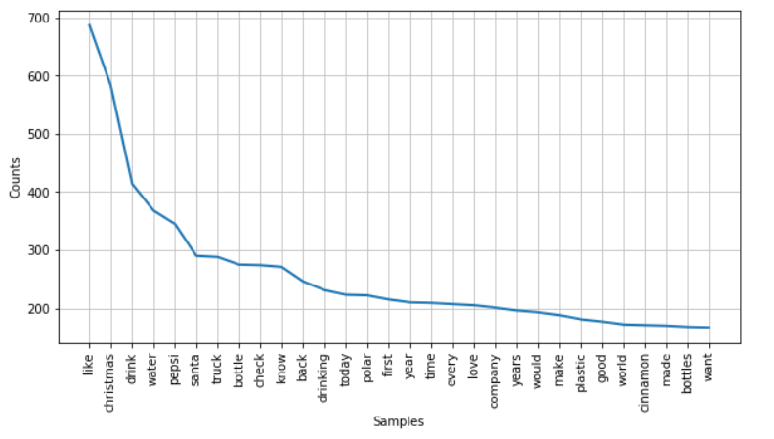
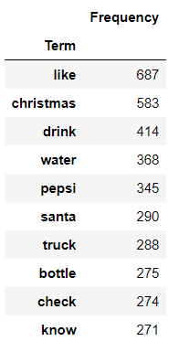
COMMON WORDS
The Top 10 words find on the tweets.

Slide 6
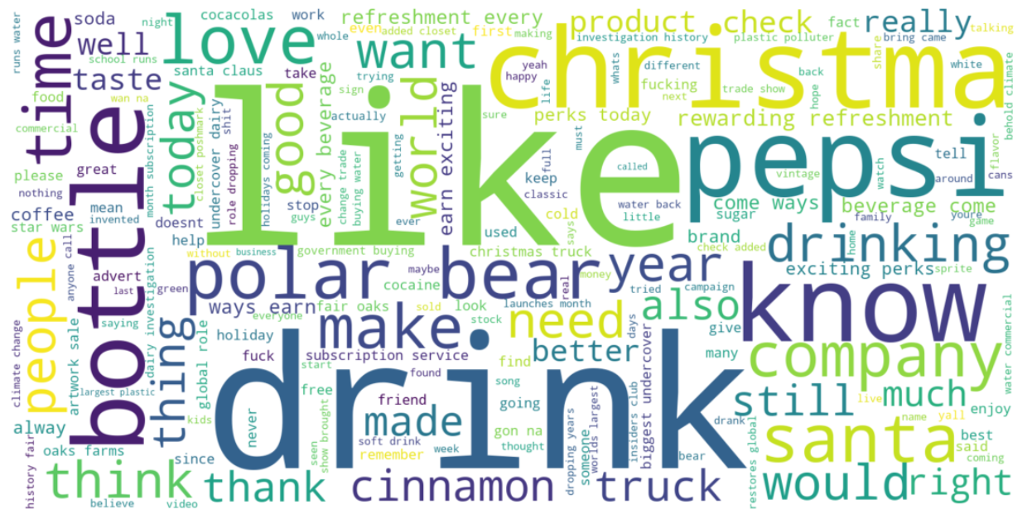
WORD CLOUD

Slide 7
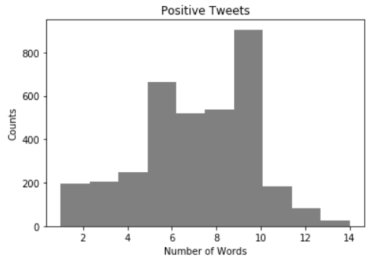
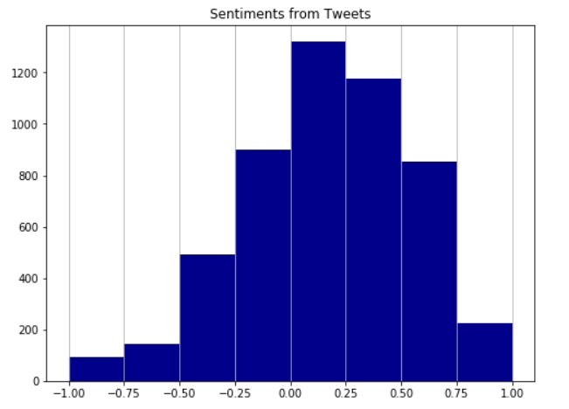
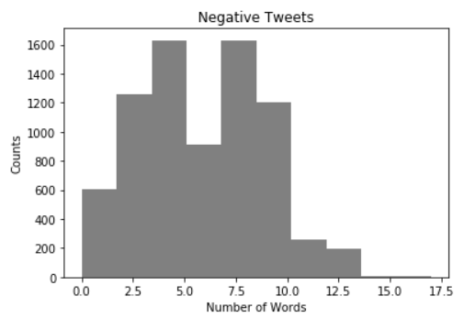
SENTIMENTAL ANALYSIS
Overall Sentiment: If the values are more concentrated in the right side than the left side, the tweets have more positive sentiments than negative sentiments.

Slide 8
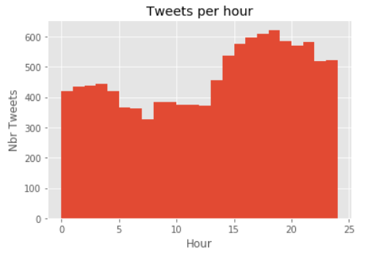
HOUR TIME
In this case, the tweets are posted mainly after 3 pm in the afternoon.

Slide 9
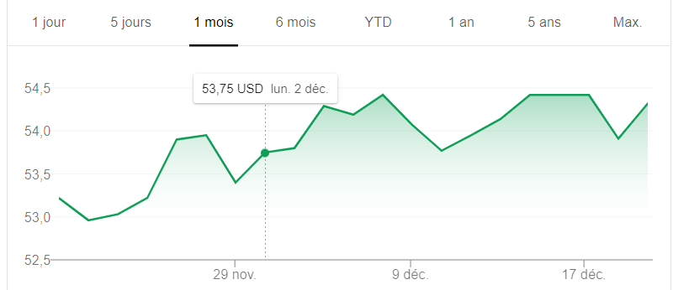
Price Stock Coca Cola

